Slide 1

Sanjivani College of Engineering, Kopargaon-423603
Sanjivani Rural Education Society’s
(An Autonomous Institute Affiliated to Savitribai Phule Pune University, Pune)
NAAC ‘A’ Grade Accredited
Department of Information Technology
(UG program, NBA Accredited)
Software Engineering Modeling & Design
“Blood Bank Management System”
SEMD incharge Dr. S. N. Gunjal
Class : SY IT B

Slide 2

Group Members :
Roll No. | PRN | Name
79 | 0124UITM1079 | Mahesh Borde
82 | 0124UITF1082 | Namrata Vetal
83 | 0124UITM1083 | Rameshwar Bhagwat
84 | 0124UITM1084 | Arjun Khajekar

Slide 3
Introduction :
The Blood Bank Management System is a software application designed to efficiently manage the process of blood donation, storage, and distribution.
It helps in maintaining accurate records of donors, blood stock, hospitals, and patients.
This system provides a platform for different users such as Admin, Doctor, Donor, and Recipient to interact with the system and perform their respective tasks.

Slide 4

Functional Requirements :
FR1: The system shall allow registration of blood donors with personal and medical details. FR2: The system shall store and manage donor information in the database. FR3: The system shall record blood donation details including blood group and quantity. FR4: The system shall update blood stock automatically after each donation. FR5: The system shall allow users to search for available blood based on blood group. FR6: The system shall allow recipients or hospitals to request blood. FR7: The system shall allow the admin to approve or reject blood requests. FR8: The system shall display real-time blood availability to users. FR9: The system shall maintain records of issued blood units. FR10: The system shall generate reports for blood stock and donation history.

Slide 5

Non Functional Requirements :
NFR1 (Performance): The system should process requests and update blood records within a few seconds. NFR2 (Security): User data and system access should be protected through authentication and secure communication. NFR3 (Usability): The system should have a simple and user-friendly interface for easy operation. NFR4 (Reliability): The system should operate continuously with minimal failure, especially during emergency situations. NFR5 (Scalability): The system should support increasing number of donors and blood records without performance issues. NFR6 (Availability): The system should be available 24/7 for accessing blood information and requests. NFR7 (Maintainability): The system should be easy to maintain, update, and troubleshoot.

Slide 6
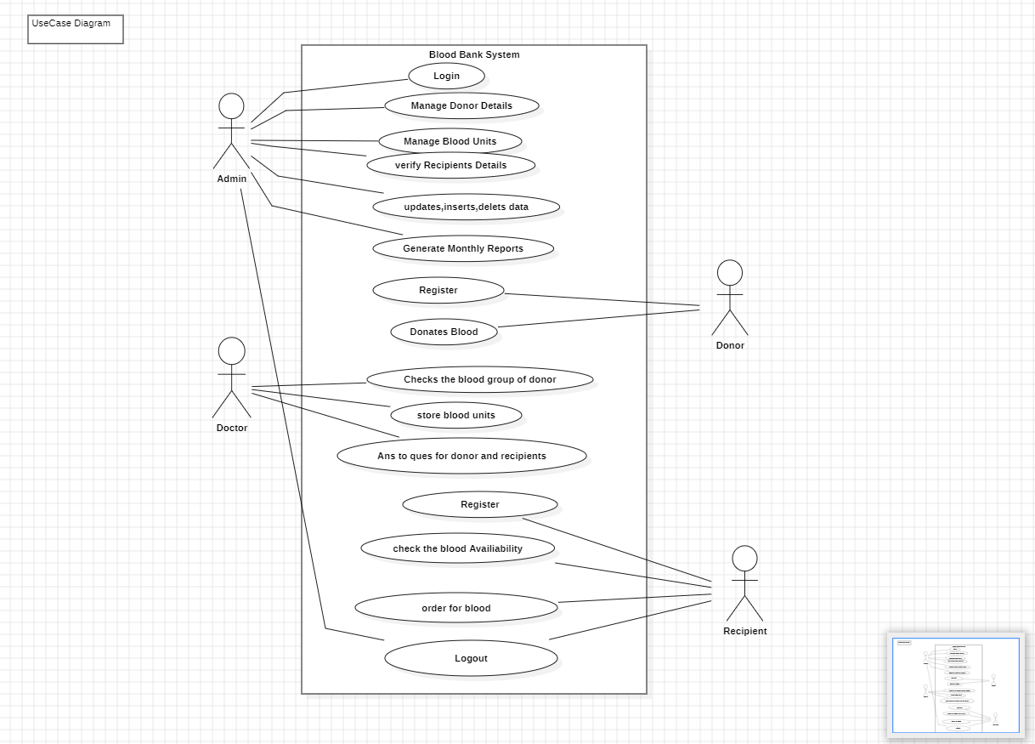
Use Case Diagram :

Slide 7
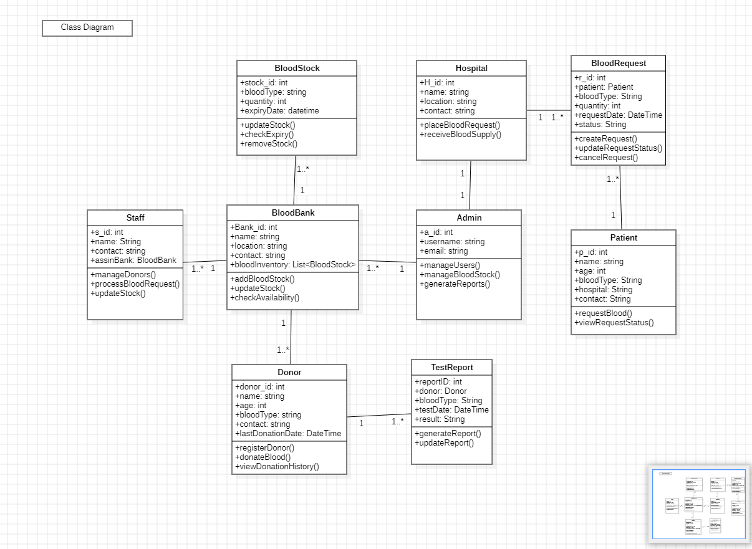
Analysis Class Diagram :

Slide 8
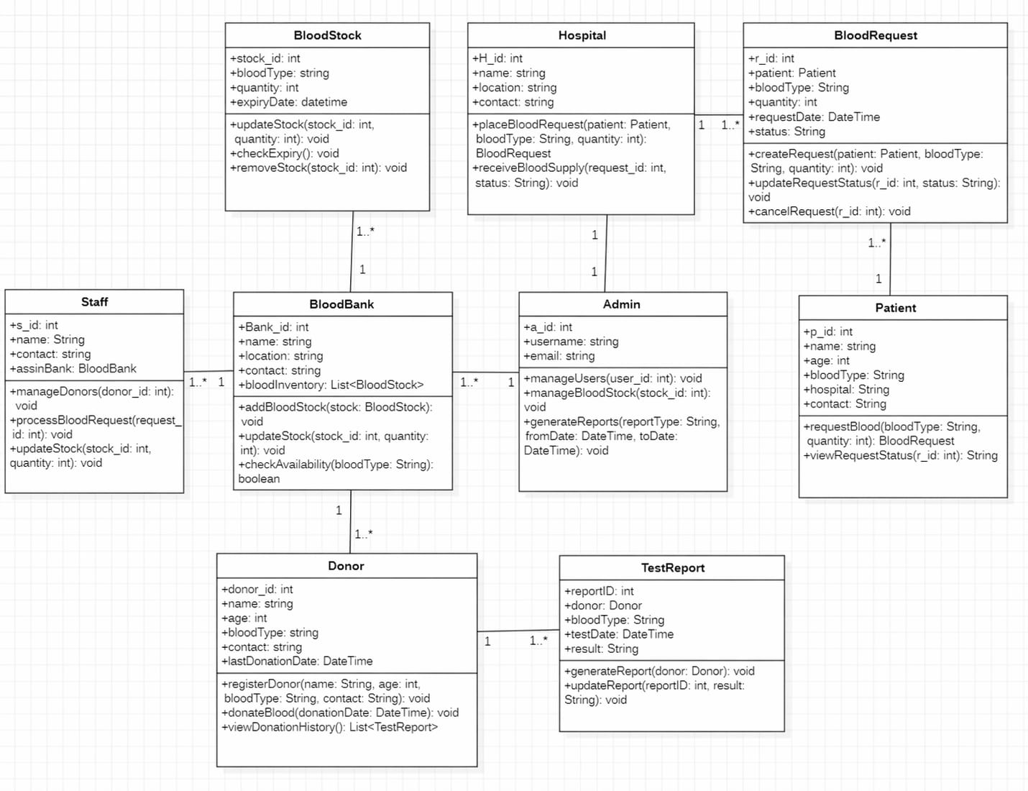
Design Class Diagram :

Slide 9
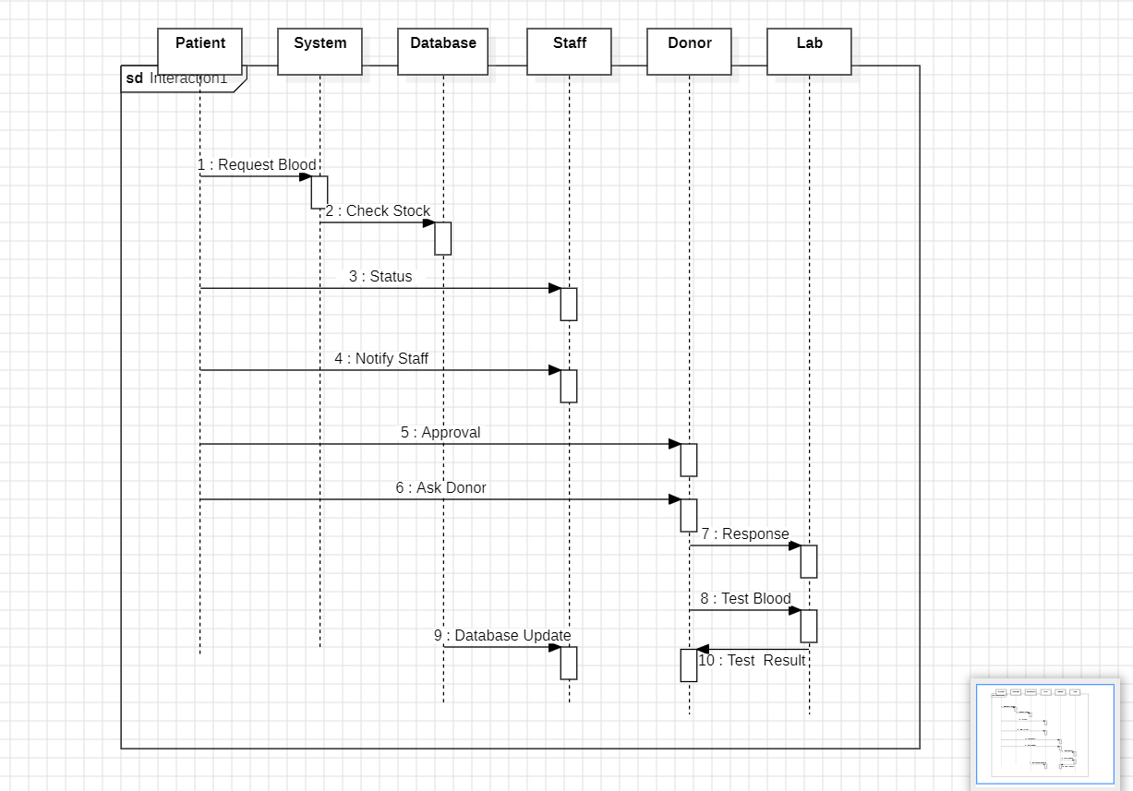
Sequence Diagram –

Slide 10
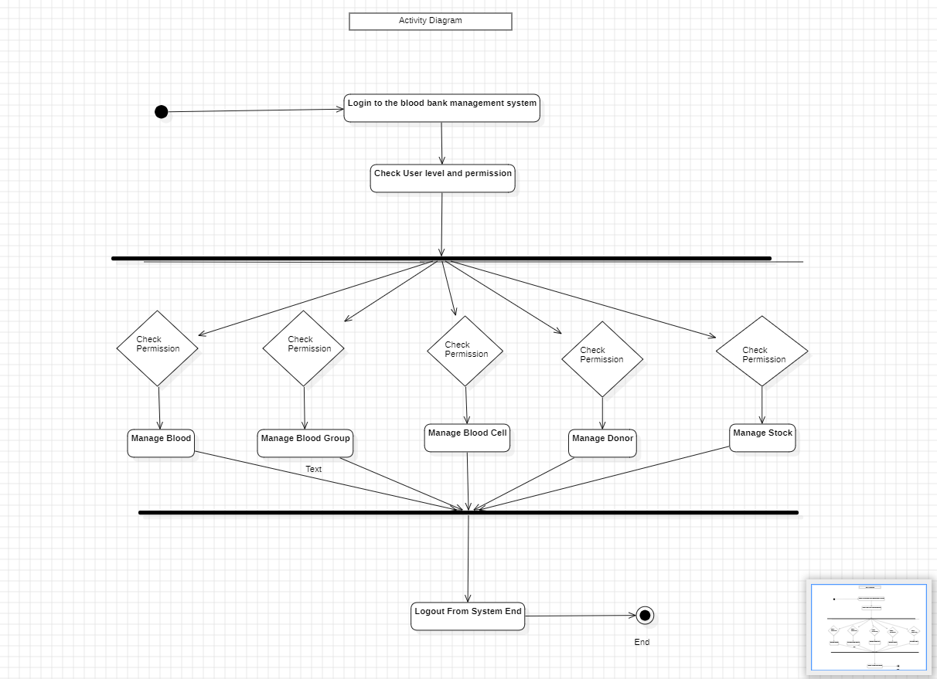
Activity Diagram :

Slide 11
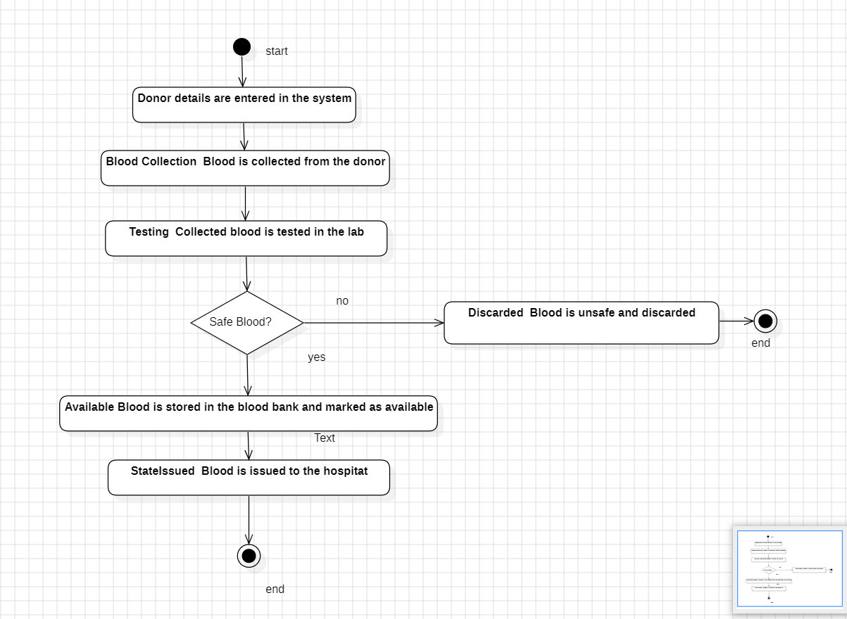
State Machine Diagram :

Slide 12
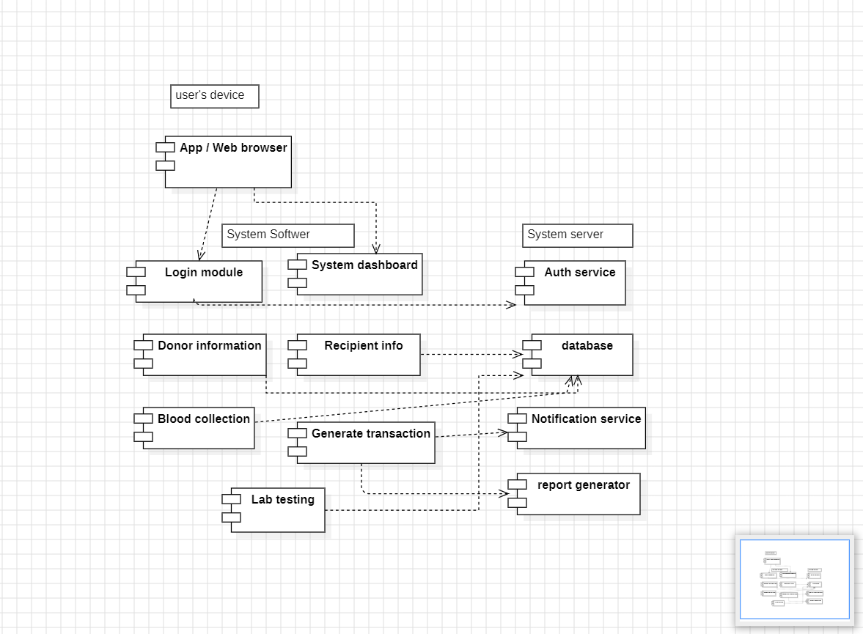
Component Diagram :

Slide 13
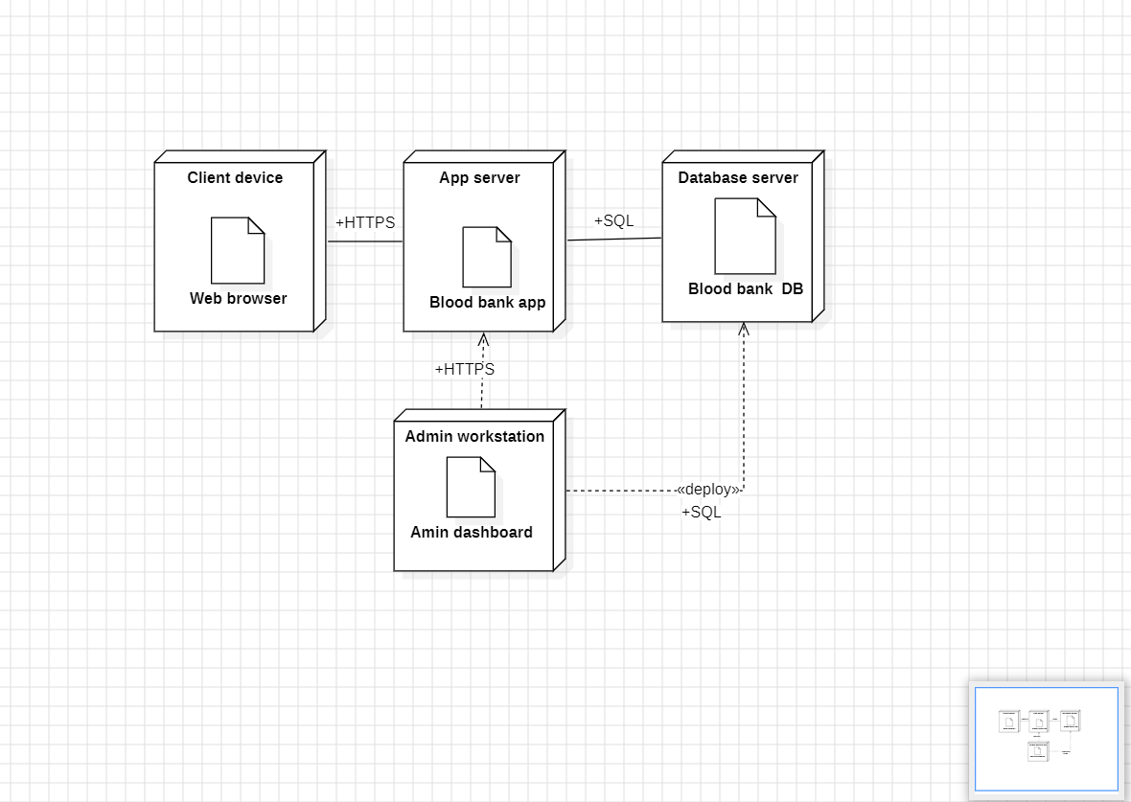
Deployment Diagram :

Slide 14
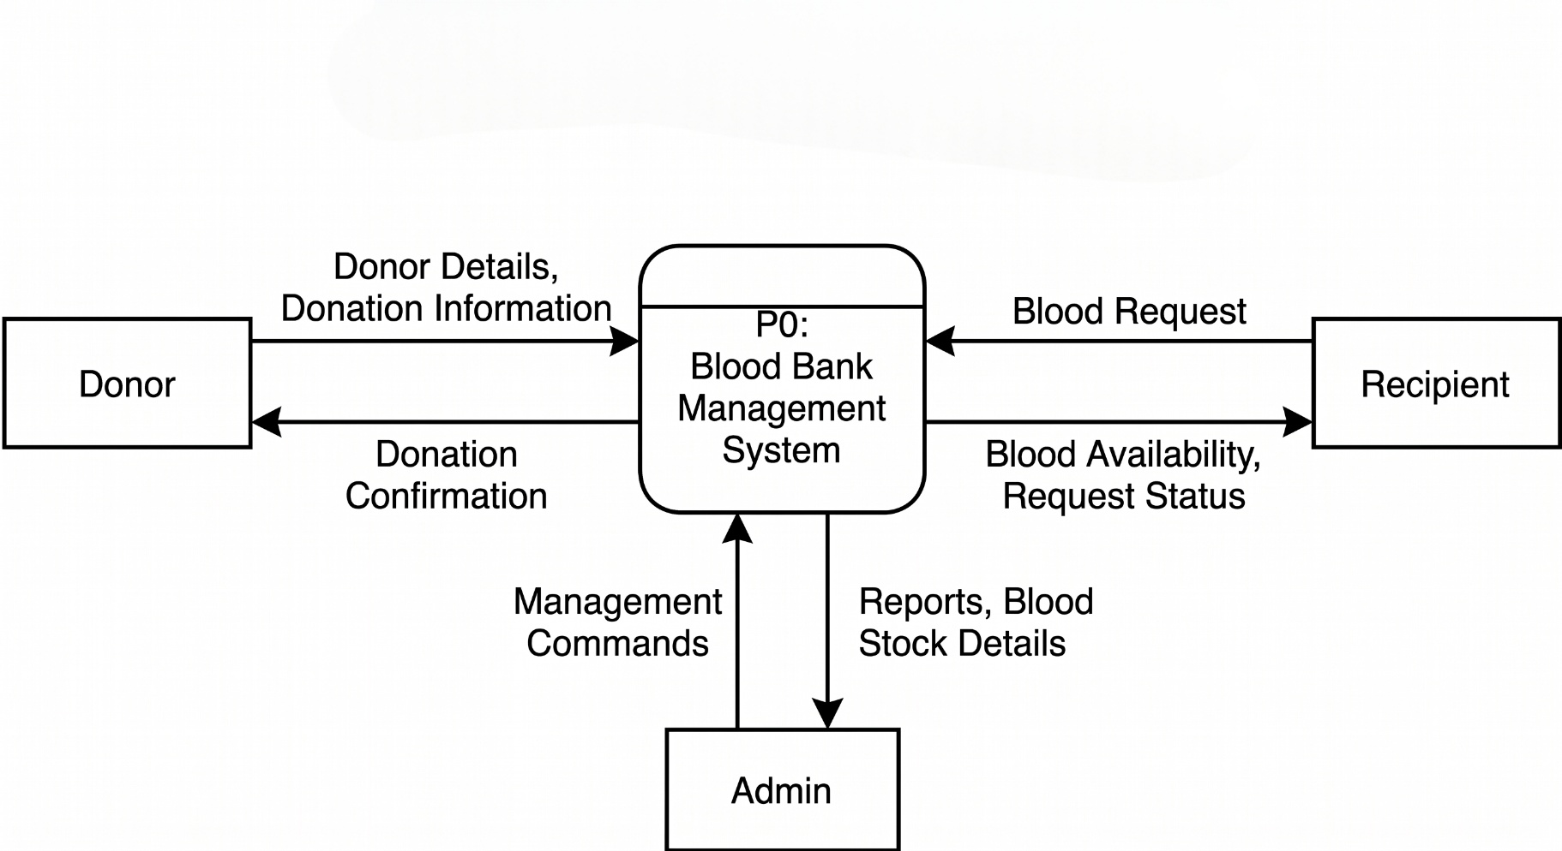
Data Flow Diagram (DFD):
DFD Level 0

Slide 15
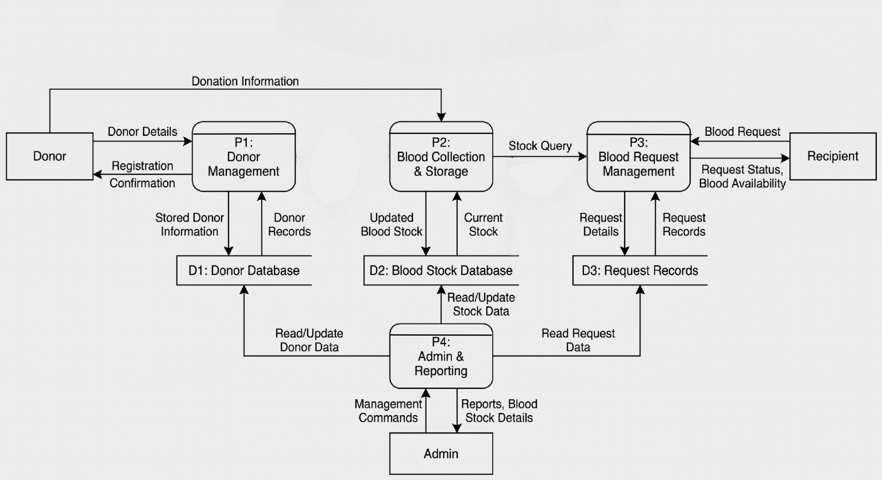
Data Flow Diagram (DFD):
DFD Level 1

Slide 16
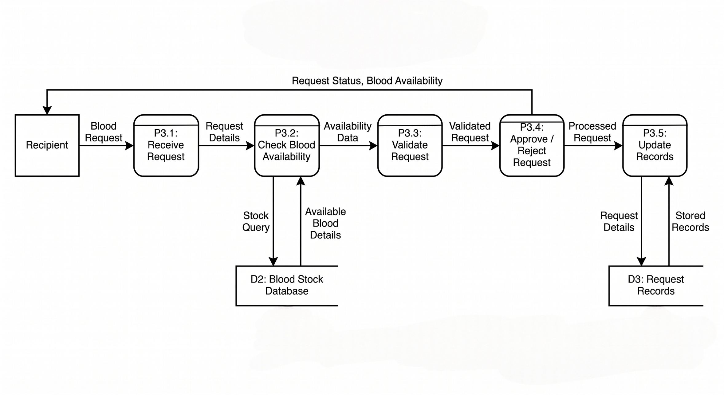
Data Flow Diagram (DFD):
DFD Level 2

Slide 17
Control Flow Diagram (CFD):

Slide 18
Conclusion:
The Blood Bank Management System provides an efficient and automated solution for managing blood donation and distribution processes. By using a centralized database and digital platform, the system ensures proper tracking of blood availability and donor information. It reduces manual effort, minimizes errors, and improves response time during emergency situations.
The integration of web or mobile applications allows users to access information and request blood easily, while real-time updates enhance decision-making. Overall, this system improves healthcare services and demonstrates how technology can modernize traditional blood bank operations.

Slide 19
References:
Blood Bank Management System – Research Papers / Study Material
MySQL Documentation – https://www.mysql.com
Web Development Documentation (HTML, CSS, JavaScript)
Software Engineering Concepts – Study Material
Online Tutorials and Technical Blogs

